Slide 1


Foundational Accounting Principles

Slide 2

Why Cover the Basics?
It is easy to get “tunnel vision.”
    How many times do we do something just because it is the way it has always been done?
    This little refresher will help you understand the why behind what we do.
    Stress and anxiety occur when expectations are at one level and reality is at a different level. Understanding what your system can do and what it cannot do will help balance expectations with reality.
Software systems can be mysterious.
  QuickBooks uses intuitive forms for most data entry tasks.
  We need to understand what should be happening in the background in order to enter, and troubleshoot, non-traditional data entry tasks.
This will allow us to use the same vocabulary in further training – to make sure we are all on the same page.

Slide 3
What is a Fund vs an Account?
Fund – a fiscal and accounting entity with a self-balancing set of accounts recording cash and other financial resources, together with related liabilities and residual equities or balances which are segregated for the purpose of carrying on specific activities or attaining certain objectives in accordance with special regulations, restrictions or limitations.
Account - is a holding cell used for gathering related balance sheet and income statement transaction data in order to summarize that data.
  A Fund has it’s own Asset accounts
    Bank accounts, Accounts Receivable accounts
  A Fund has it’s own Liability accounts
    Payroll Liability accounts, Sales Tax Liability account
  A Fund has it’s own Equity accounts
    Fund Balance accounts (reserved, restricted, etc.)
    Net Income: Income/Revenue accounts, Expense accounts
Notes:
The basic core of Governmental Accounting is based on the Fund.

Slide 4
GASB 34 - Funds
Governmental Funds
  General Fund – the chief operating fund of the city.
  Special Revenue Funds – funds which track proceeds from specific sources that are usually restricted for specific use by law, regulations or by the entity providing or authorizing the revenue.
  Debt Service Funds – funds accounting for the payment of interest and principal on the city’s long-term debt.
  Capital Project Funds – funds accounting for the resources used in the acquisition of major capital facilities and capital assets.
  Permanent Funds – funds legally restricted to the extent that only the earnings, and not the principal, may be used for specific purposes.
Proprietary / Business / Enterprise Funds
  Funds tracking the proceeds of revenue produced from activities financed and operated in a manner similar to private business.
Notes:
Trust & Agency Funds

Slide 5
Balance Sheet Accounts
Asset Accounts – what you own
  Short-term Assets
    cash, notes receivable, accounts receivable, prepaid expenses, inventory
  Long-term Assets
    land, buildings, equipment
Liability Accounts – what you owe
  Short-term Liabilities
    notes payable, accounts payable, wages payable, taxes payable, rent payable, interest payable, customer deposits, unearned revenue, credit cards
  Long-term Liabilities
    Bonds, notes
Equity Accounts – what you are worth
  Fund Balance Equity
  Revenue and Expense Accounts (Retained Earnings, Net Income/Loss)

Slide 6
The Accounting Equation
Liabilities
& Equity
Assets

Slide 7
  Fund – a fiscal and accounting entity with a self-balancing set of accounts…
 | Governmental |  |  |  |  | Enterprise
 | General | Special Revenues | Capital Projects | Debt Serv. | Perm | Proprietary
ASSETS
Bank Accounts Accounts Receivable Undeposited Funds | 0.00 0.00 0.00 | 0.00 0.00 0.00 | 0.00 0.00 0.00 | 0.00 0.00 0.00 | 0.00 0.00 0.00 | 0.00 0.00 0.00
LIABILITIES
Accounts Payable Payroll Tax Liabilities Sales Tax Payable | 0.00 0.00 0.00 | 0.00 0.00 0.00 | 0.00 0.00 0.00 | 0.00 0.00 0.00 | 0.00 0.00 0.00 | 0.00 0.00 0.00
EQUITY
Fund Balances Net Income Income Expense Transfers In/Out | 0.00 0.00 0.00 0.00 0.00 | 0.00 0.00 0.00 0.00 0.00 | 0.00 0.00 0.00 0.00 0.00 | 0.00 0.00 0.00 0.00 0.00 | 0.00 0.00 0.00 0.00 0.00 | 0.00 0.00 0.00 0.00 0.00

Slide 8
Income Statement Accounts
Income / Revenue (Increase Fund Balance)
  Revenue Sources: Taxes, Licenses and Permits, Use of Money & Property, Intergovernmental, Special Assessments, Charges for Services, Miscellaneous, Other Financing Sources
Expense (Decrease Fund Balance)
  Activity Types (Governmental Activities, Proprietary/Business Activities)
  Governmental Functions (Public Safety, Public Works, Culture and Recreation, Economic and Community Development, Health and Social Services, General Government)
  Activities / Departments (Fire Department, Police Department, Parks Department, Roads Department, Library Department, City Hall Department, Clerk/Treasurer’s Department, Mayor/Council’s Department, etc.)
  Proprietary/Business Segment (Water, Sewer, Garbage, Electric, etc.)
  Objects (Repairs & Maintenance, Postage, Equipment, Utilities, Wages, vehicle Expense, Continuing Education, Contractual Services, etc.)
Notes:
Or Profit & Loss
Approximately 5,000 accounts in the default Chart of Accounts
We want to be careful to not add too many more
Remember the External Decision Makers
Use info to compare with other Cities
Who defines the accounts?
GASB
Federal Agencies (FEMA, USDA, CDBG, etc)
State Legislature
Local Government (Budget Process)

Slide 9
  Fund – a fiscal and accounting entity with a self-balancing set of accounts…
 | Governmental |  |  |  |  | Enterprise
 | General | Special Revenues | Capital Projects | Debt Serv. | Perm | Proprietary
Income
Taxes Intergovernmental Charges for Services | 0.00 0.00 0.00 | 0.00 0.00 0.00 | 0.00 0.00 0.00 | 0.00 0.00 0.00 | 0.00 0.00 0.00 | 0.00 0.00 0.00
Expenses
Governmental Public Safety Fire Department Equipment Public Works Roads Equipment Proprietary Water Equipment | 0.00 0.00 | 0.00 0.00 | 0.00 0.00 | 0.00 0.00 | 0.00 0.00 | 0.00

Slide 10
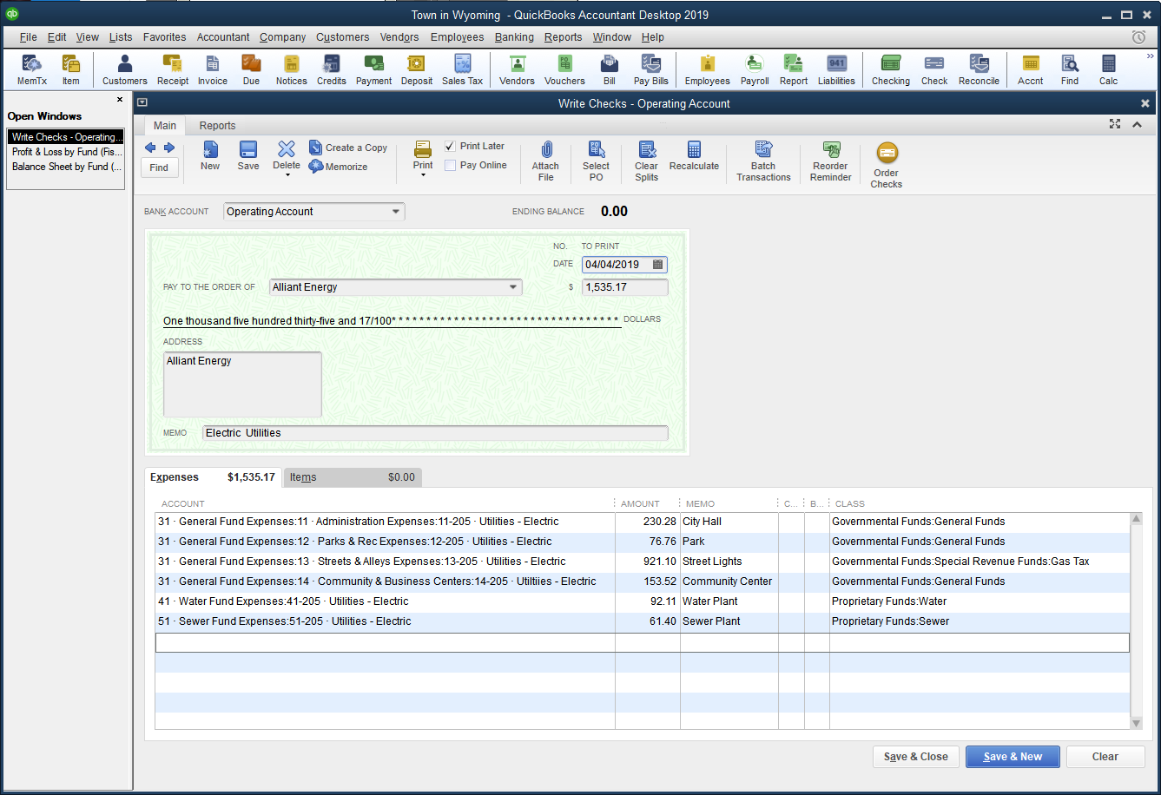
Data Entry – Paying Bills
There are two ways to pay bills
  In Pure Cash Basis – we only use checks

Slide 11
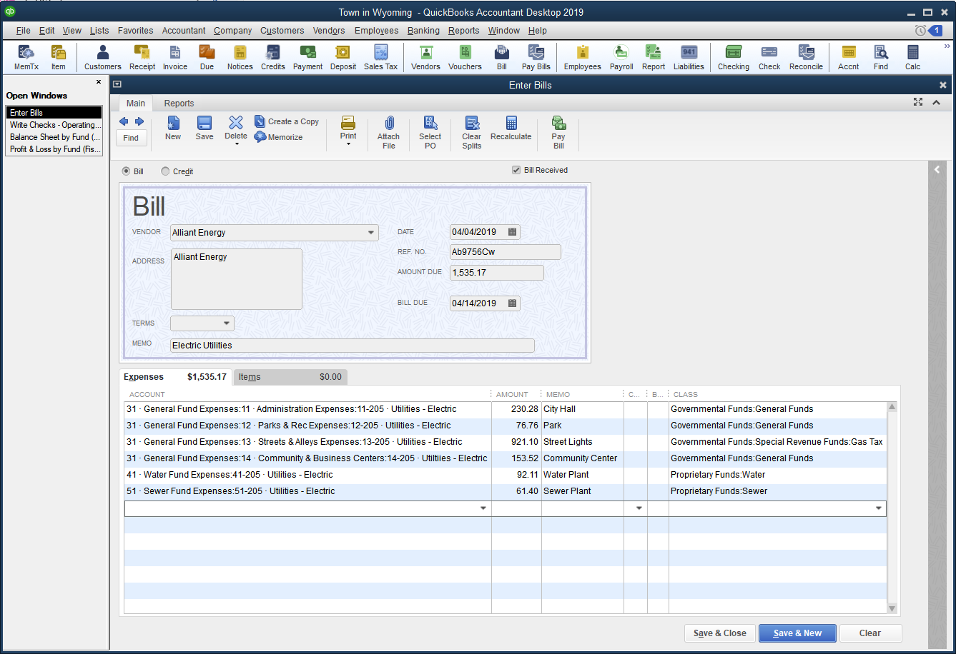
Data Entry – Paying Bills
There are two ways to pay bills
  In Pure Accrual – we use the bill pay system

Slide 12
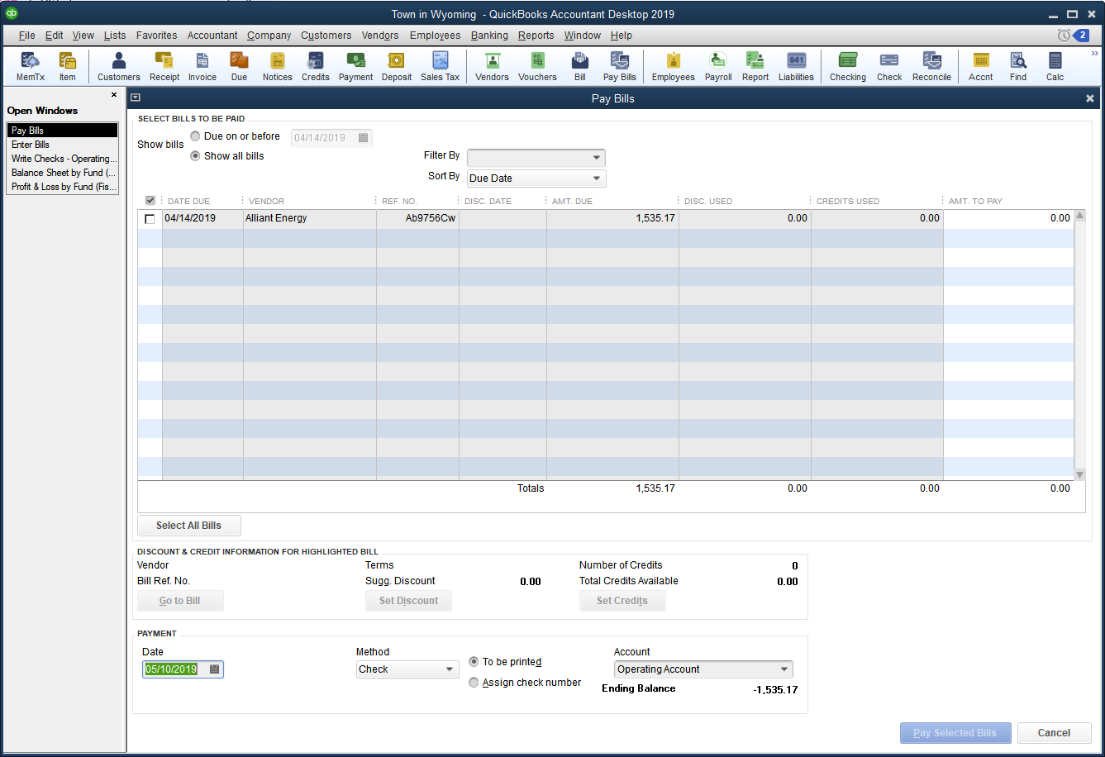
Data Entry – Paying Bills
There are two ways to pay bills
  In Pure Accrual – we use the bill pay system

Slide 13
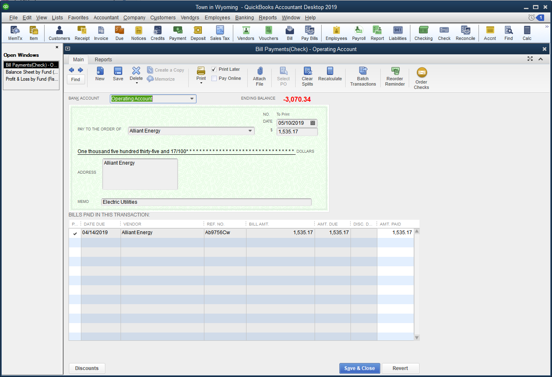
Data Entry – Paying Bills
There are two ways to pay bills
  In Pure Accrual – we use the bill pay system

Slide 14
Data Entry – Paying Bills
Paying Bills – stuff to remember
  Your accounting basis determines how you pay bills
    Pure Cash: Just use checks
    Pure Accrual: Just use the Bill Pay system
    Modified Accrual: Proprietary Funds use the Bill Pay system, Governmental Funds just use Checks
  When using the Bill Pay system, the date of the Bill is the date the expense hits the Profit & Loss and Budget reports
    Make sure that date isn’t already Closed
  You can get a report for Claims to Be Approved by either using Checks or Bills.
    If using both Checks and Bills, you will need two reports
  All transactions need both an Account and a Class (Fund)
  All transactions need a memo
    One for the Public and optional individual line item memos for internal use

Slide 15
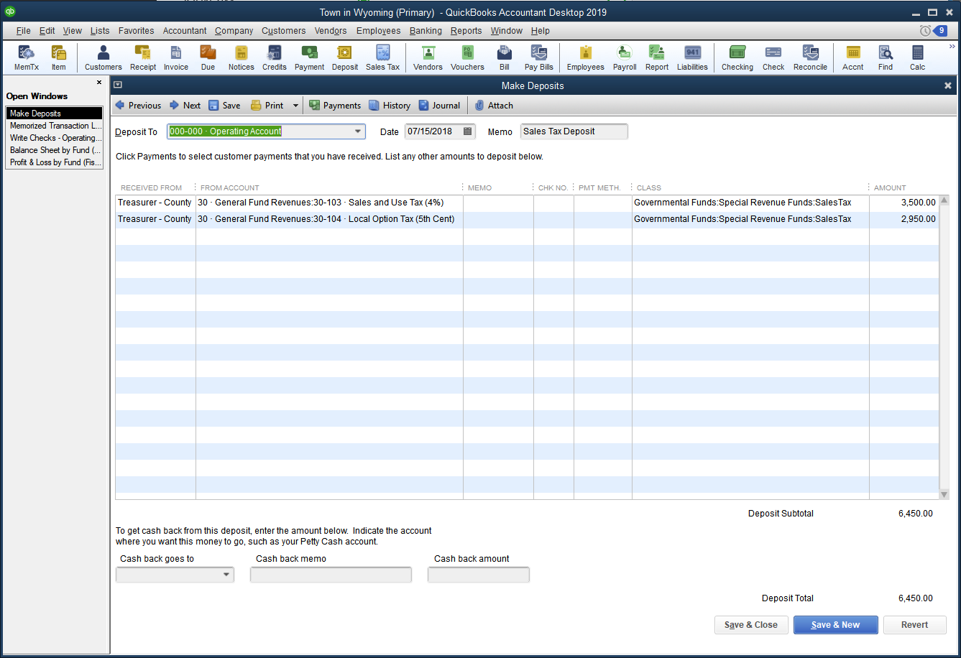
Data Entry – Making Deposits

Slide 16
Utility Billing
Utility Billing, Payments, Receipts and Deposits
  QuickBooks does a good job handling:
    On-site sales with sales receipts, invoicing for future payments, customer payments, statements, credit memos and deposits
  However, QuickBooks struggles with
    Taking a previous meter reading and subtracting a current reading in order to calculate usage
    Taking a usage amount and pro-rating it at certain tiers
    Using multiple sales tax rates for different sales items on the same invoice
  The solution is to
    Create memorized transactions for every customer
    Use a third-party invoicing system like ClerkBooks

Slide 17
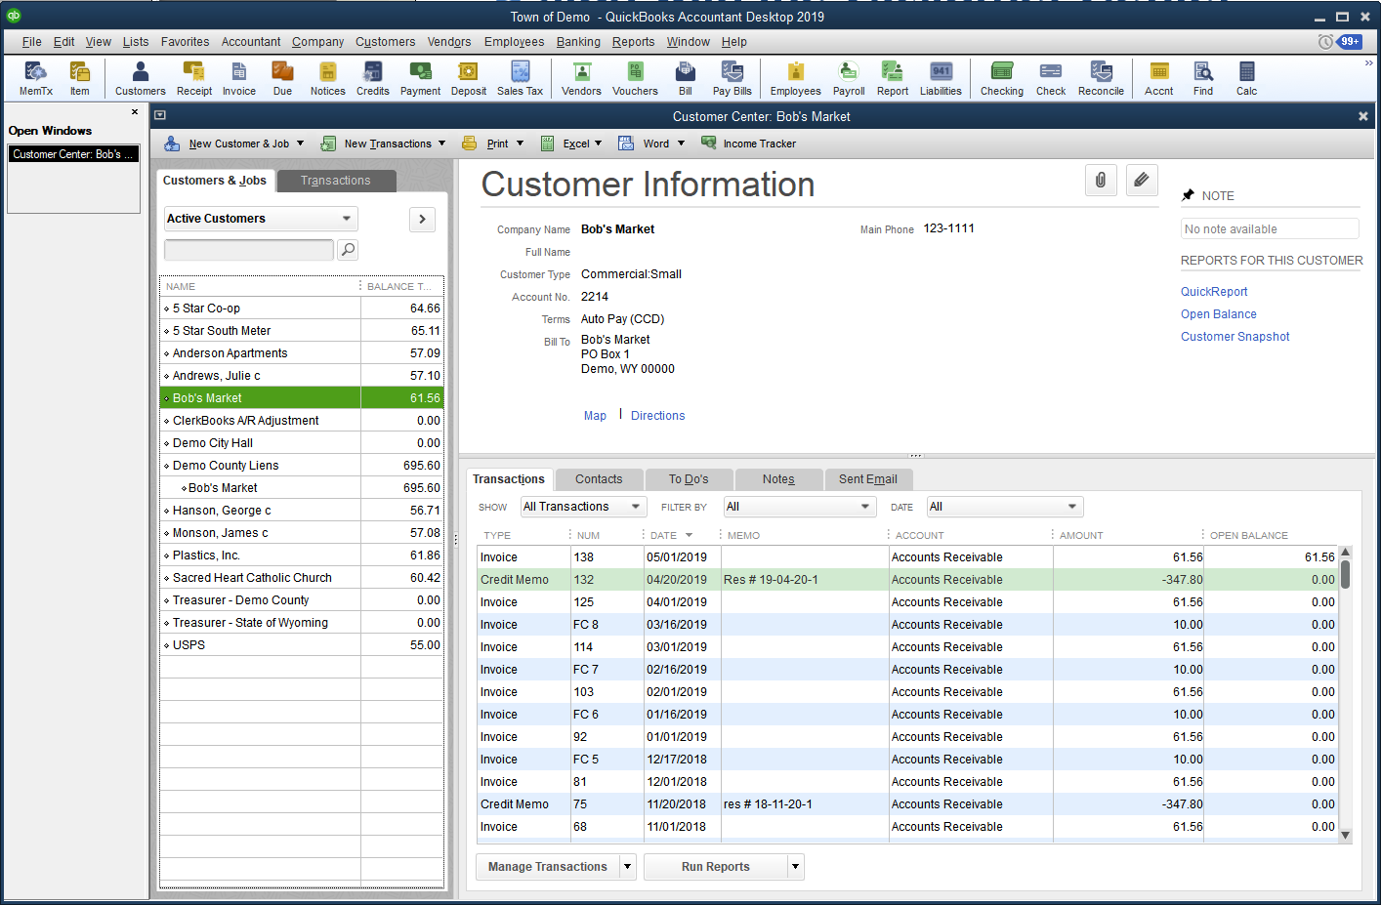
Utility Billing
Start with the Customer Center

Slide 18
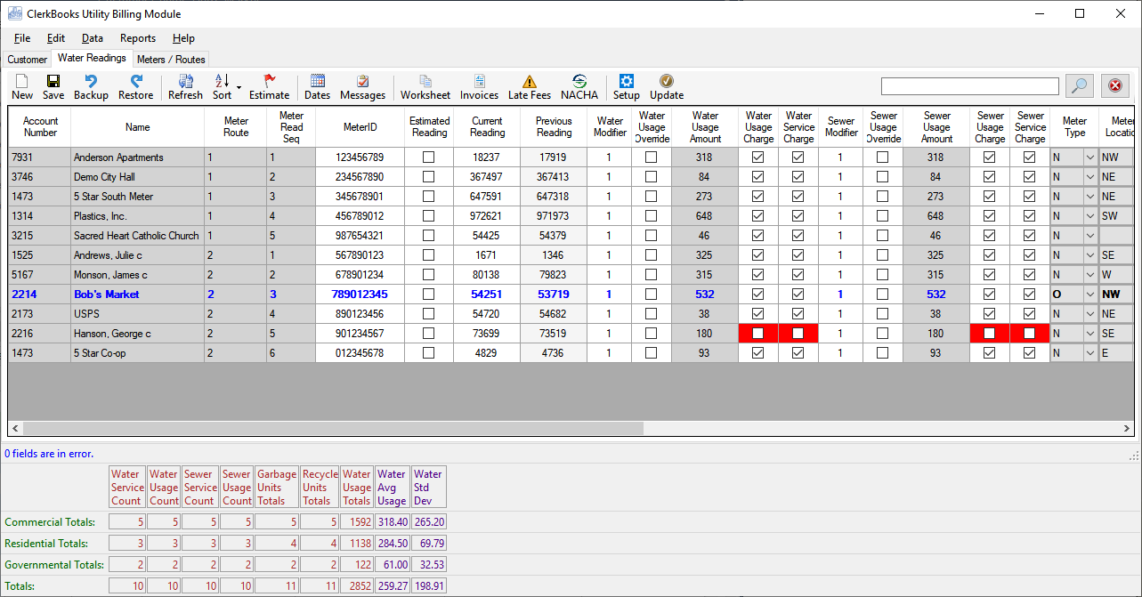
Utility Billing
Manage Services, Routes and Meter Readings in Utility Billing Module

Slide 19
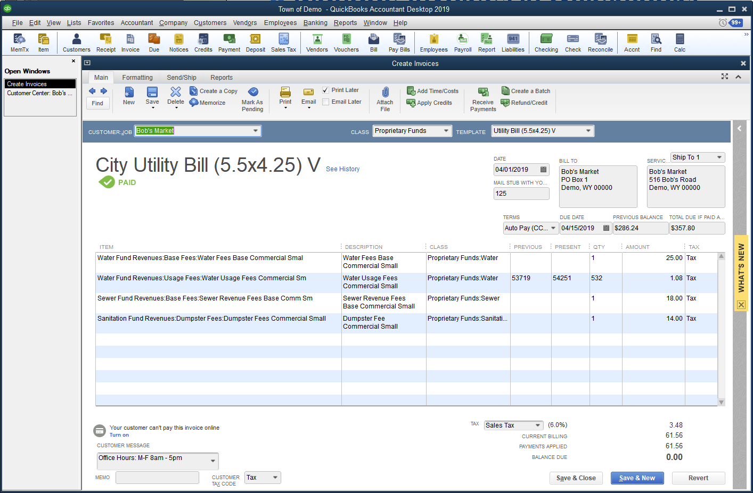
Utility Billing
Manage Invoices in QuickBooks

Slide 20
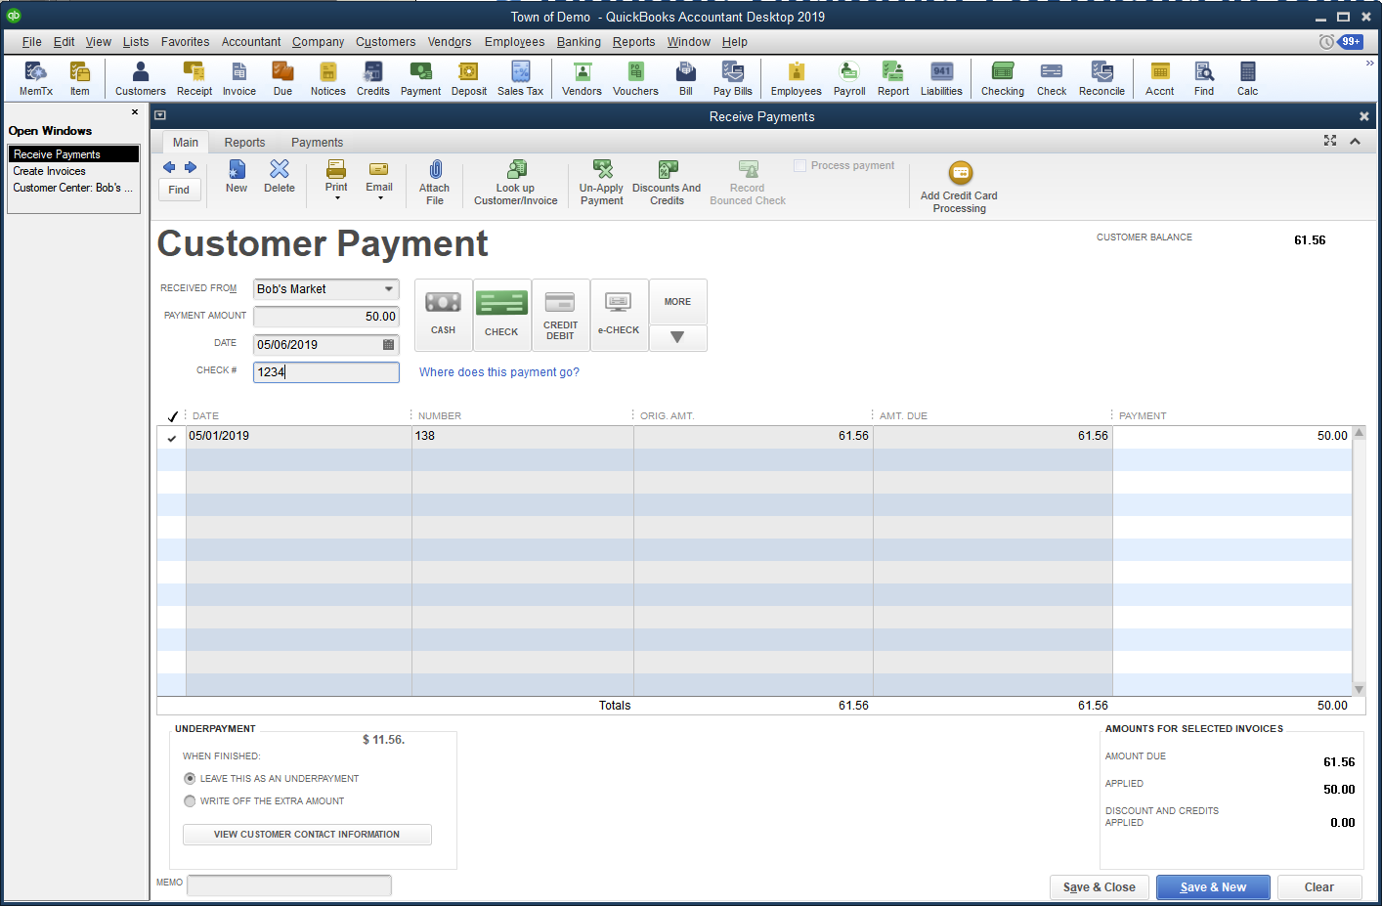
Utility Billing
Manage Customer Payments in QuickBooks

Slide 21
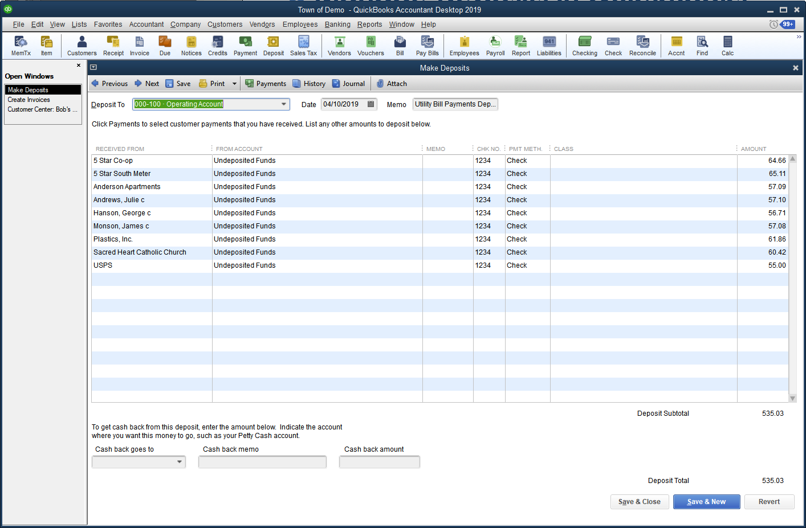
Utility Billing
Make Deposits in QuickBooks

Slide 22
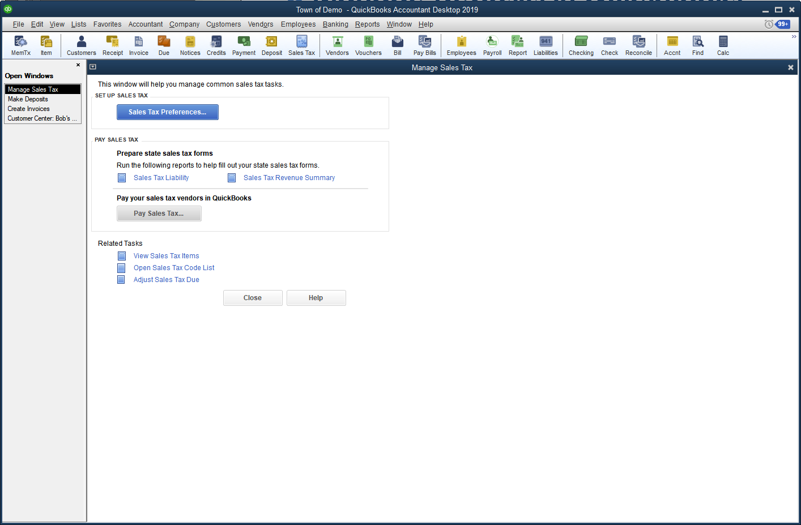
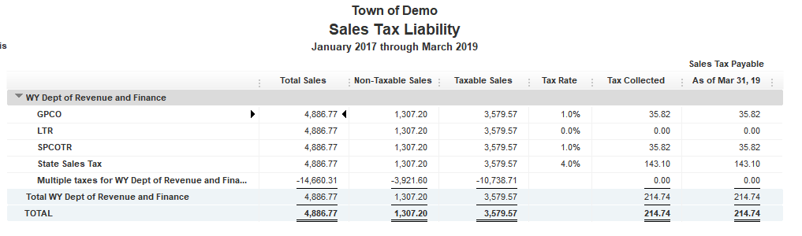
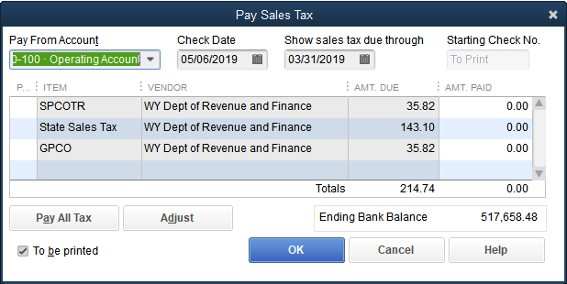
Utility Billing
Manage Sales Taxes in QuickBooks

Slide 23
Payroll
QuickBooks has several options for payroll
  Manual Payroll
    create paychecks, calculates gross pay by multiplying payrate times hours, calculates % or flat rate taxes and benefit deductions, tracks sick and vacation time earned, taken and remaining, creates paystubs, creates liability checks
  Enhanced Payroll Subscription
    $450 per year plus $2 per employee per month
    Includes everything in Manual Payroll plus state and federal tax tables, direct deposit, eFile, ePay and print 941s, W2s, 1099s on plain paper
  Full Service Payroll
    $80 per month=$960 per year plus $4 per employee per month
    They will do payroll for you

Slide 24
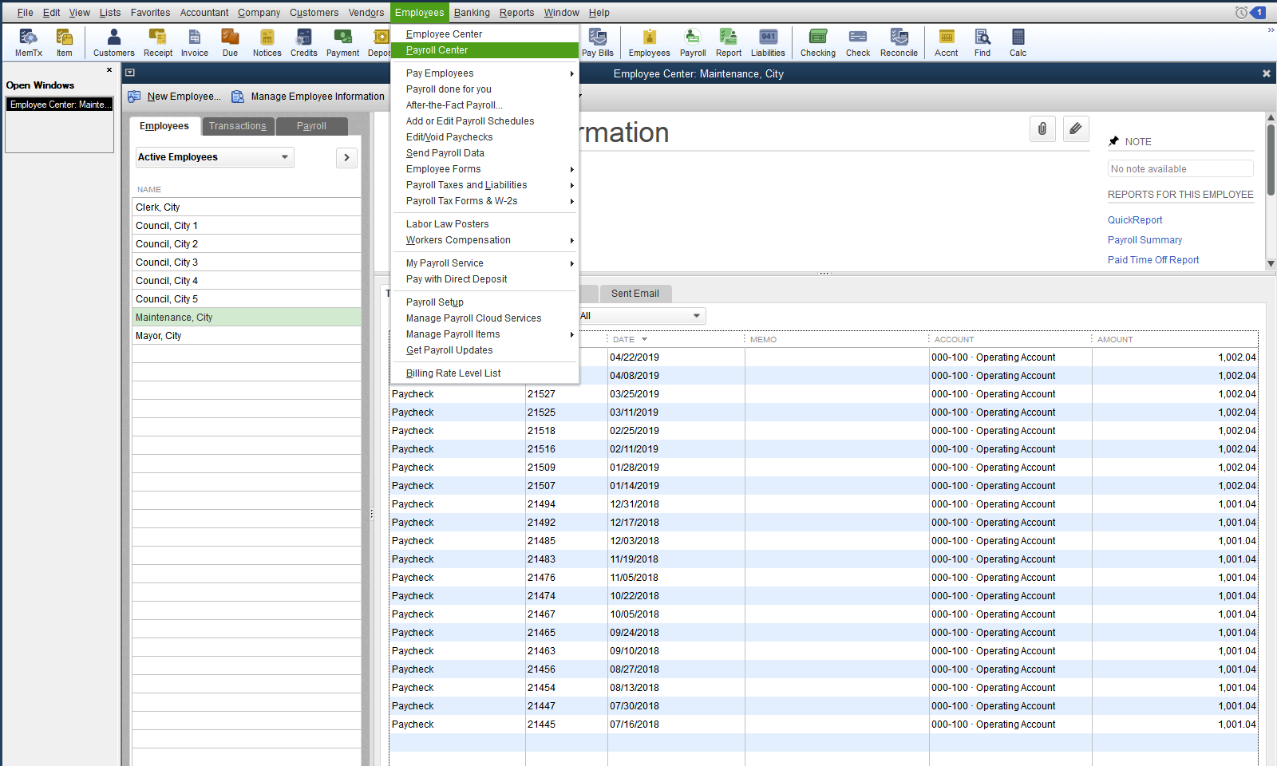
Payroll
Payroll Center

Slide 25
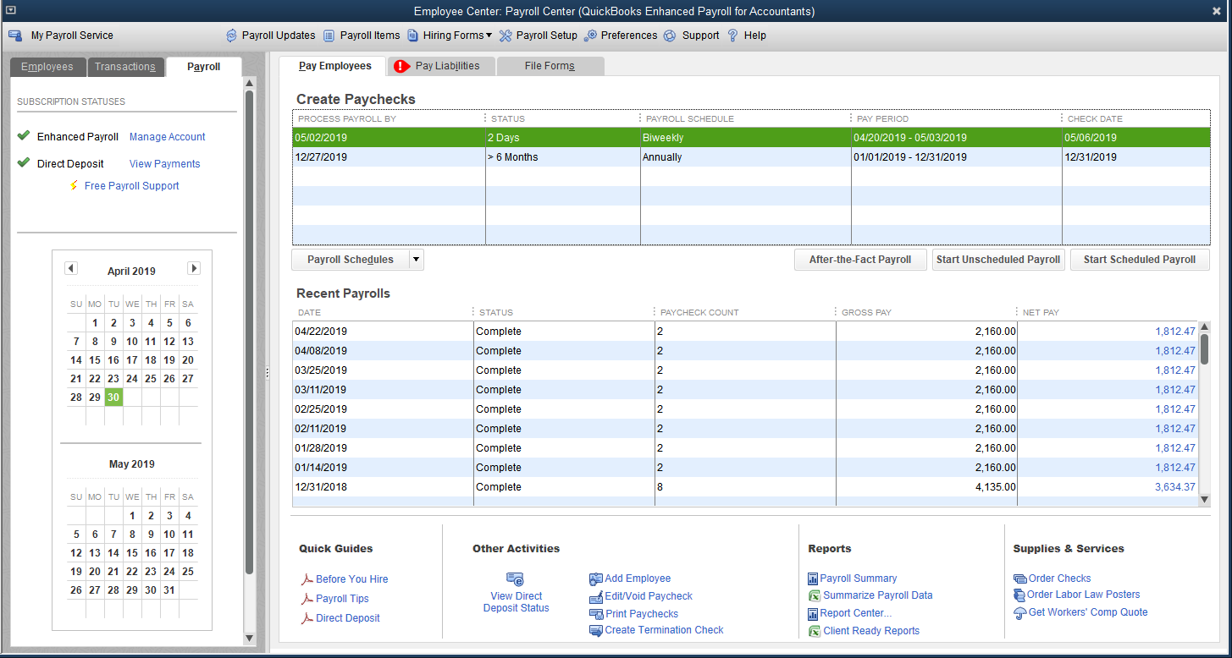
Payroll
Payroll Schedules

Slide 26
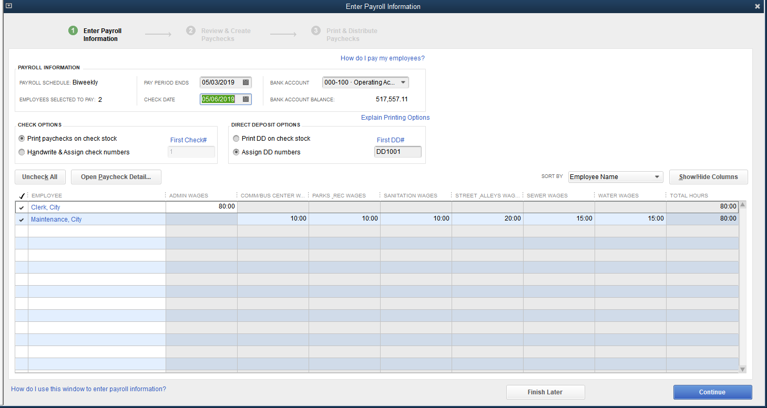
Payroll
Creating Paychecks
  Adding Hours

Slide 27
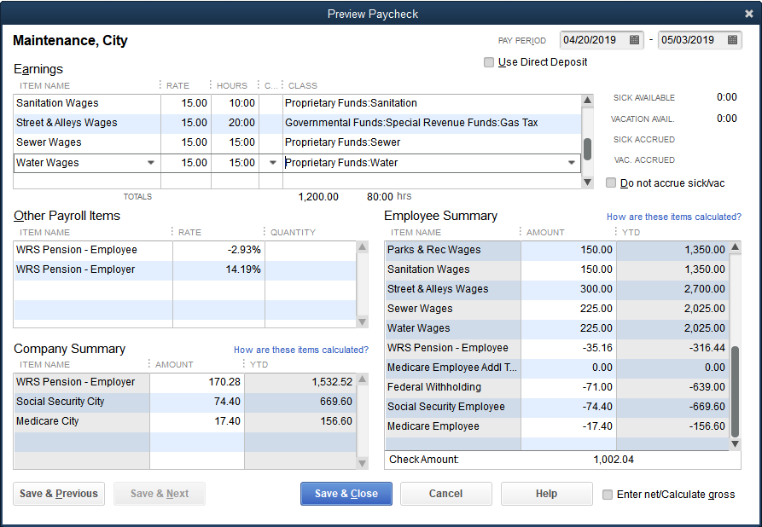
Data Entry
Creating Paychecks
  Paycheck Detail

Slide 28
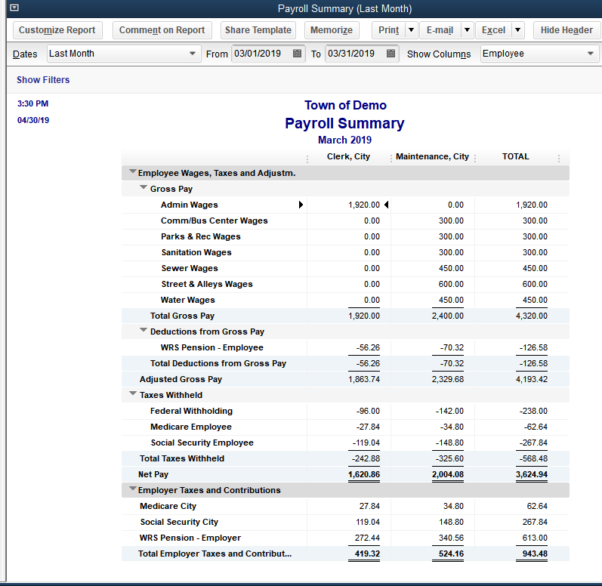
Paying Liabilities
Payroll Summary
  Print this every time you make a payment (before making the payment)

Slide 29
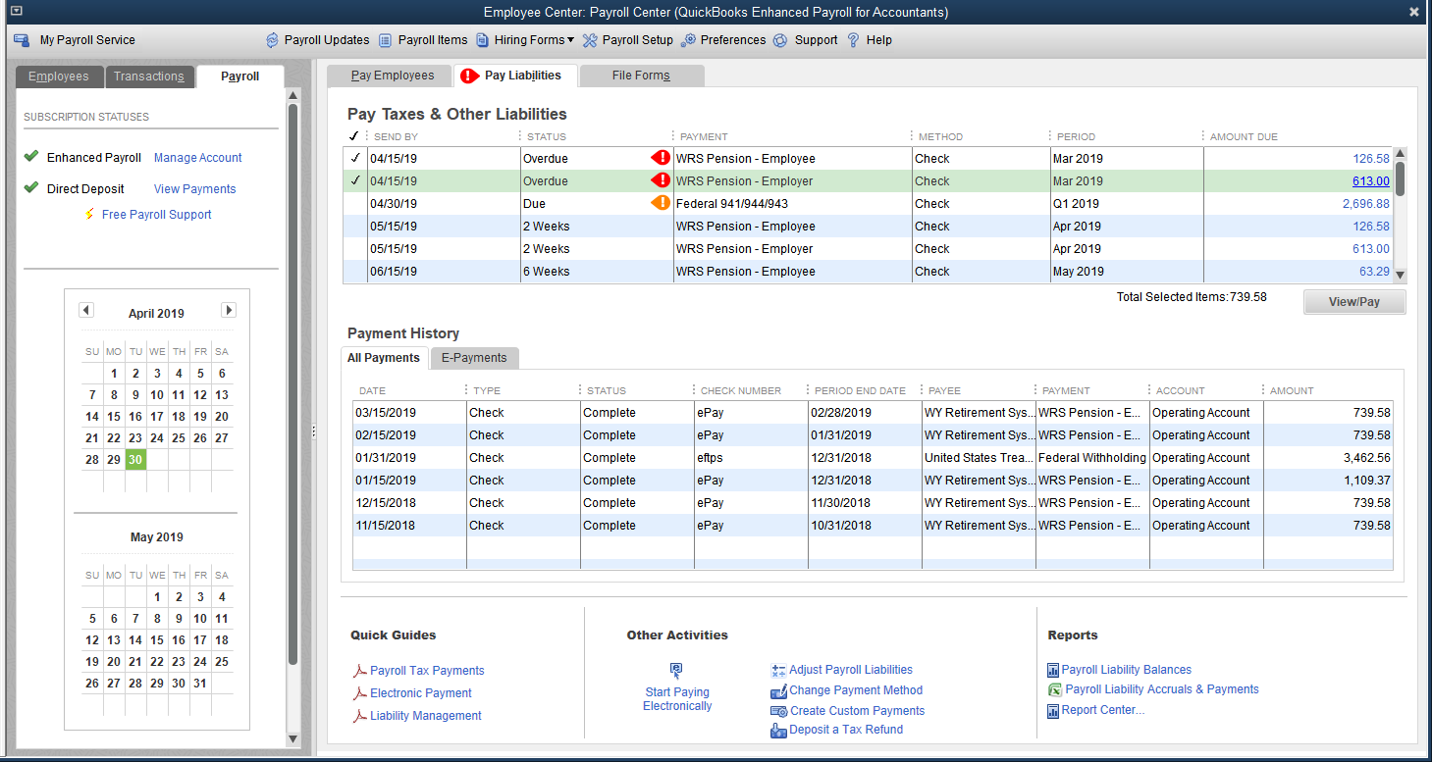
Paying Liabilities
Liability Schedules

Slide 30
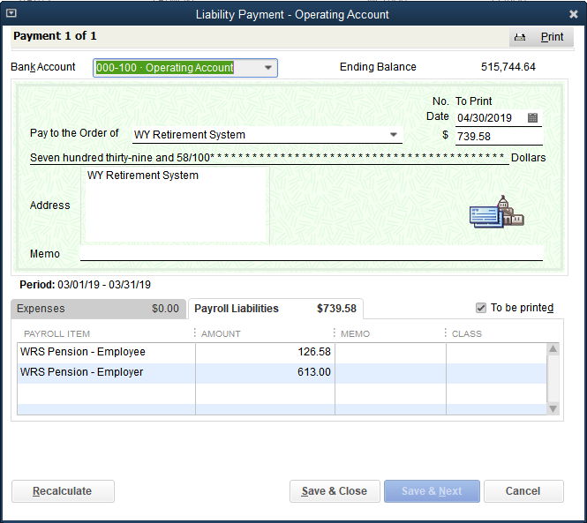
Paying Liabilities
Liability Checks

Slide 31
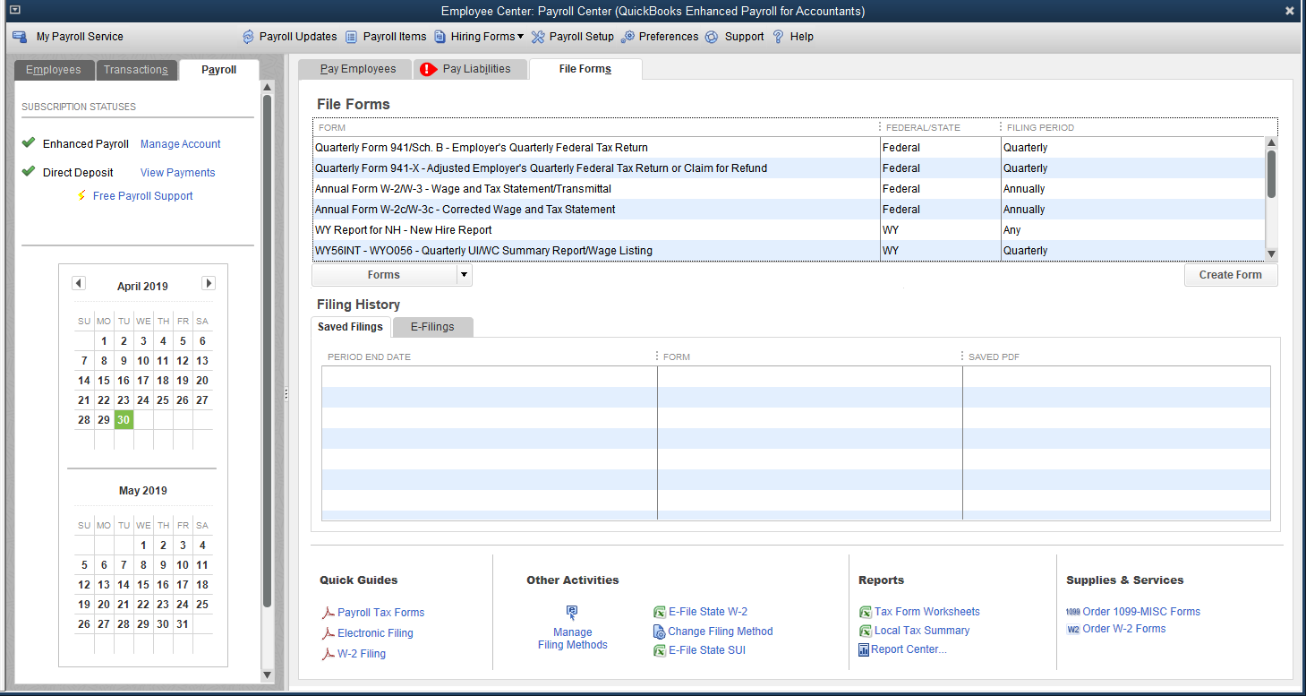
Paying Liabilities
File Forms

Slide 32
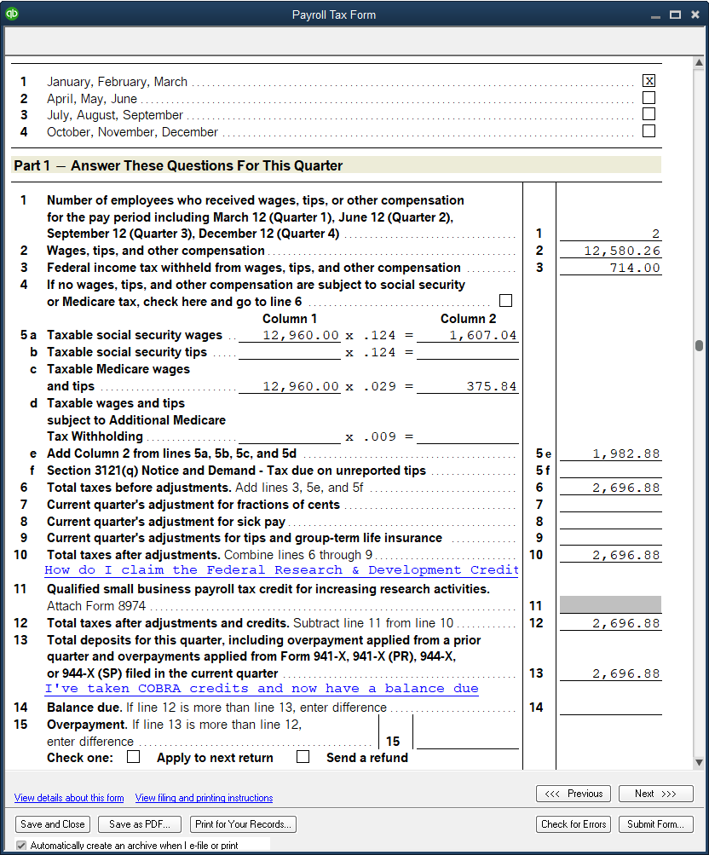
Paying Liabilities
File
Forms

