Slide 1
Tough Transactions
2020 User Conference
© 2020 ClerkBooks, Inc

Slide 2
Loans
Benefits of using Cash Basis for loans
QuickBooks will match your Iowa AFR (no need for additional conversion at the end of the year)
Much easier to close out the books
Benefits of using Accrual Basis for loans
QuickBooks will track your loan balances, making your annual debt reporting easier and giving the Council a better picture of the City’s financial health
Makes reporting to USDA much easier
Note: If loans are entered as Accrual Basis, you may want to track Asset value of the loan as well, otherwise your Fund Balance will be goofy.
Using Modified Cash or Modified Accrual
A fund can be setup for Net Position to track debt and assets as Accrual but allow Cash Basis by simply ignoring the Net Position fund.
© 2020 ClerkBooks, Inc

Slide 3
Loans
In Pure Cash Basis, there are no loans
When you take out a loan, all the money is entered as income (Proceeds of Debt)
When you make a payment, all of the money is entered as an expense (Debt Service – Principal, Debt Service – Interest)
© 2020 ClerkBooks, Inc

Slide 4
Loans
In Accrual Basis, loans are a liability
When you take out a loan, all the money is entered as a short or long-term liability account
When you make a payment, principal comes out of the liability account, interest goes in as an expense
© 2020 ClerkBooks, Inc

Slide 5
NSF
When someone bounces a check:
The bank subtracts from your checkbook
The bank may add an additional charge
The customer still needs to pay their original balance
The city may charge a penalty
All of this can get tricky, so we created a memorized transaction
© 2020 ClerkBooks, Inc

Slide 6
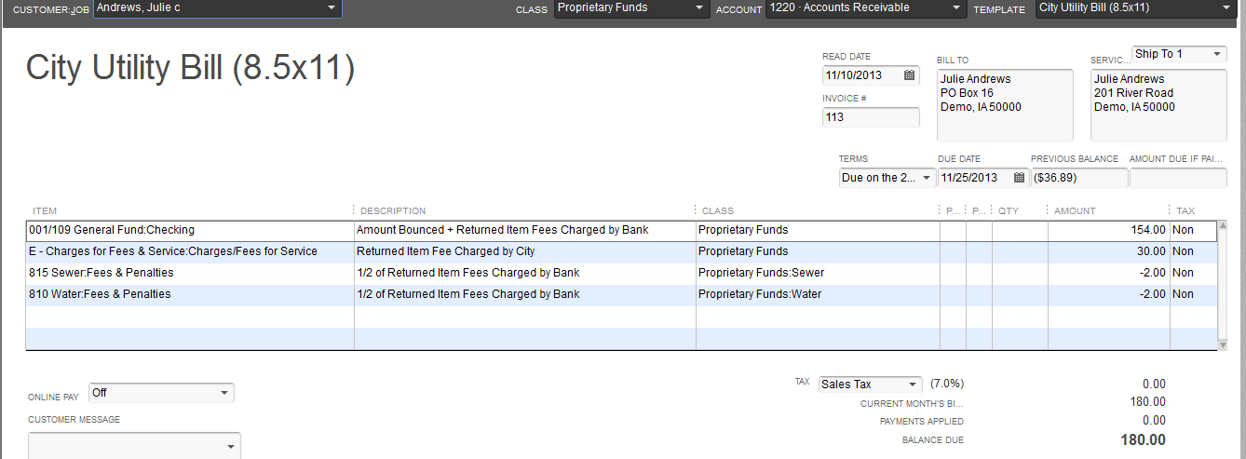
NSF
Select a Customer
Enter the date the check bounced
Enter the amount of the check that bounced, plus any fees charged by the bank
Enter the amount charged by the City as a penalty
Split the amount charged by the bank between the funds
The balance due will be added to the customers account and deducted from the checking account balance
© 2020 ClerkBooks, Inc

Slide 7
Utility Deposits
We have 3 memorized transactions for utility deposits
The invoice and sales receipt add to the account used to track utility deposit income (pure cash basis) or utility deposit liability (modified cash basis)
The credit memo applies a credit to the customer account
The credit can be used to pay an invoice or can be converted to a check
© 2020 ClerkBooks, Inc

Slide 8
Utility Deposits
There is a report in the Memorized Reports/Utility Billing section: Deposit Detail Report
© 2020 ClerkBooks, Inc

Slide 9
Write Offs
Writing off or correcting transactions from previous periods can be tricky
NEVER edit, void or delete the original transaction
ALWAYS create a transaction in the current accounting period
Writing off, or editing transactions after the fact, can red flag an auditor for potential embezzlement issues.
Try to avoid writing off or editing transactions
When necessary: document, Document, DOCUMENT
Using the same transaction numbers helps you find both the original and edited transaction in one search
Write comments on the paper copy and in the QuickBooks file
Always have the Mayor &/or Council approve (and document their approval)
© 2020 ClerkBooks, Inc

Slide 10
Write Offs
To write off a check, create a deposit
Use the same account or item and class
Use the original check number in the deposit memo
Create a note to remind yourself, and to inform the auditor, why the check is being wrote off
Edit the memo of the original transaction
© 2020 ClerkBooks, Inc

Slide 11
Write Offs
To edit a check, create a zero dollar check
Use the same account or item and class (negative $)
Create an additional line item with the correct account or item and class (positive $)
Use the original check number as the new check number
Create a note to remind yourself, and to inform the auditor, why the check is being corrected
Edit the memo of the original transaction
© 2020 ClerkBooks, Inc

Slide 12
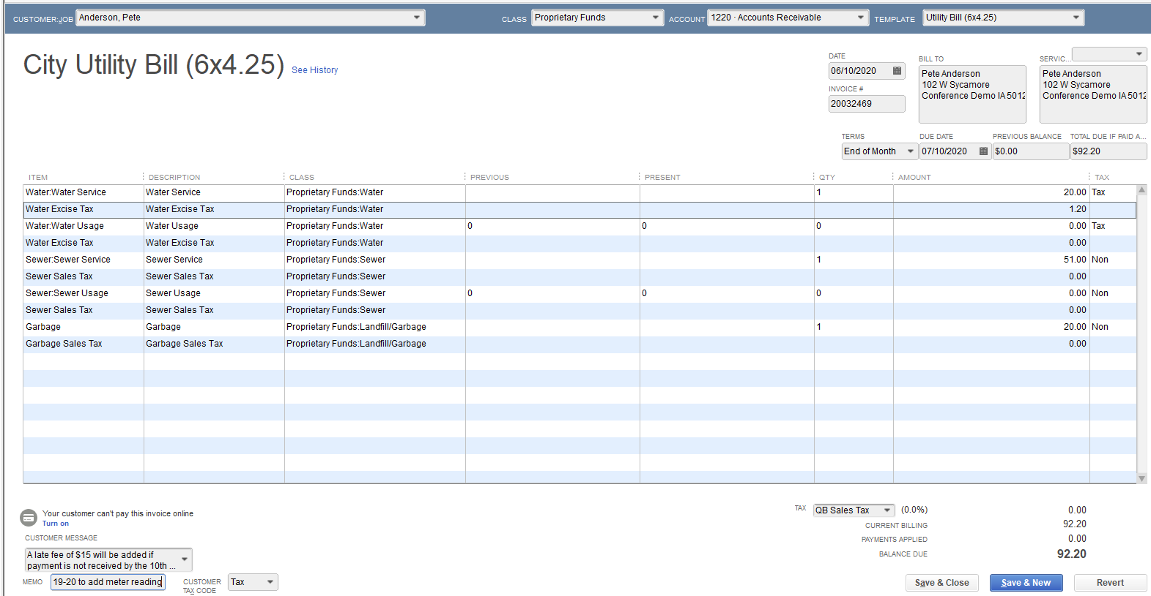
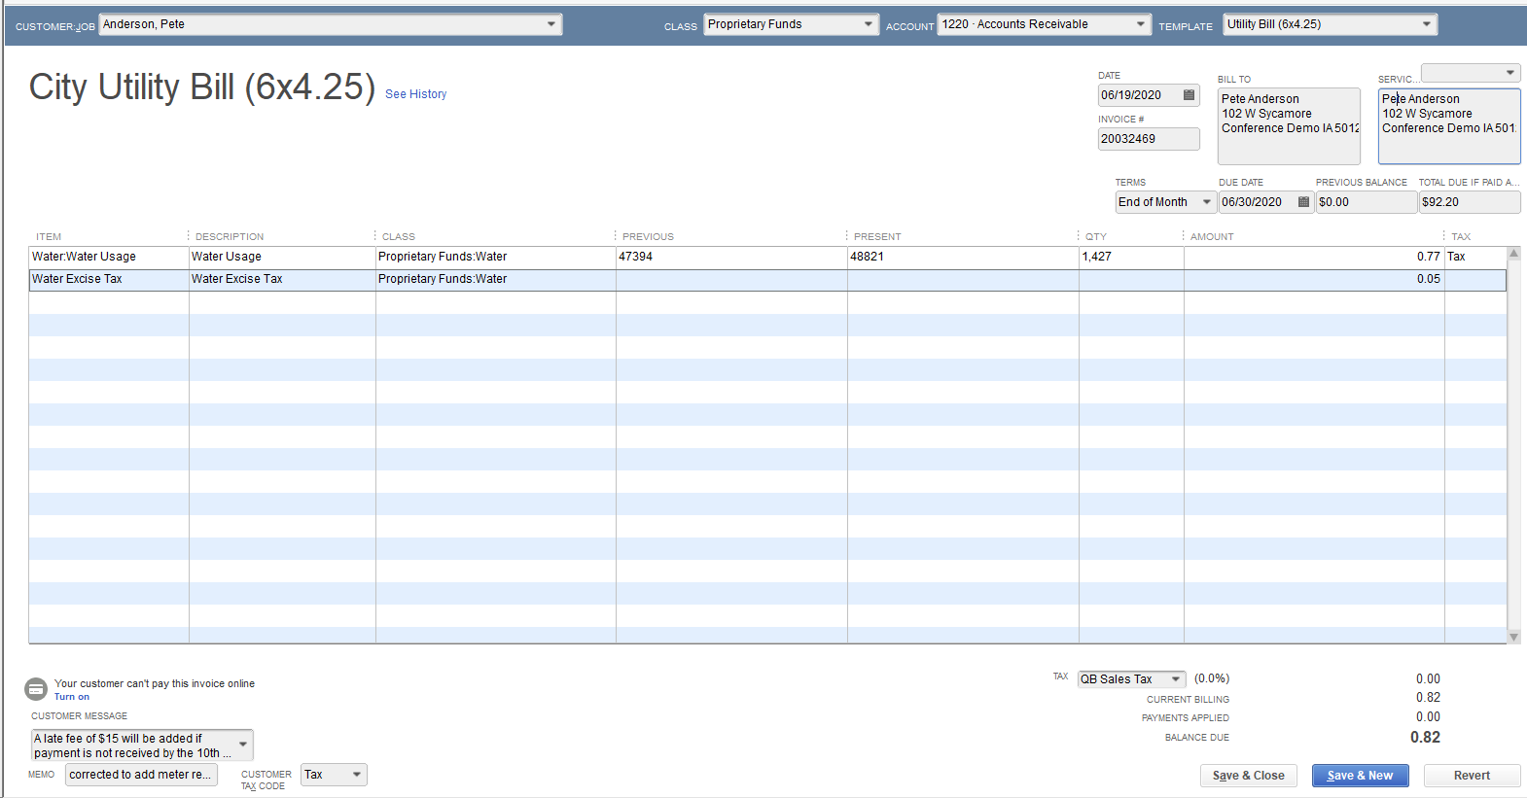
Write Offs
To increase a utility bill
Open the original invoice and click the “Create a Copy” button. Edit the new invoice as necessary
Add the original invoice number and original date to the new invoice in the memo field, as well as a note reminding you and the auditor why the utility bill is being increased

Slide 13
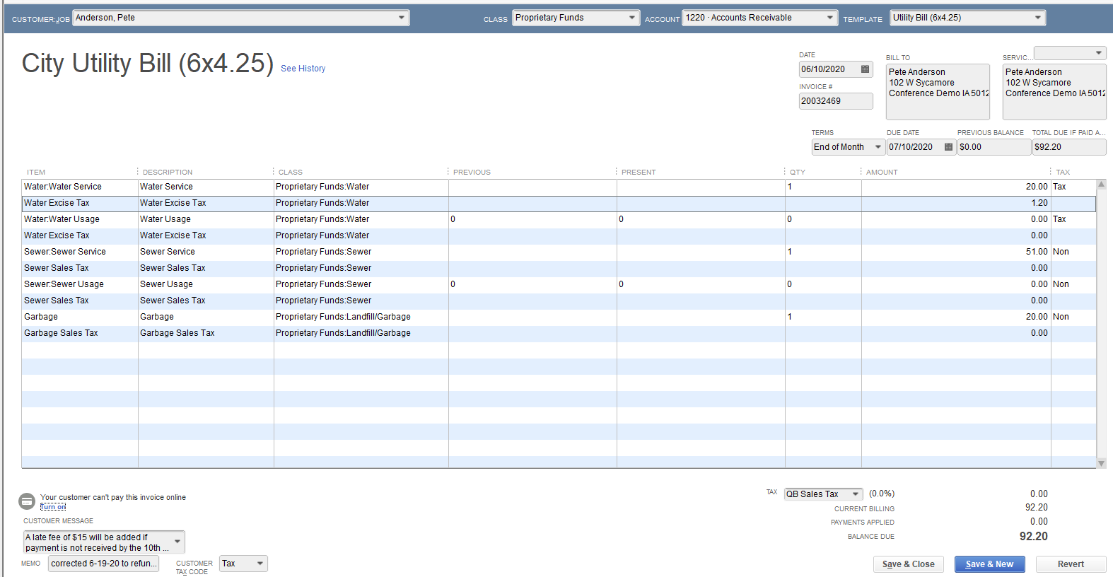
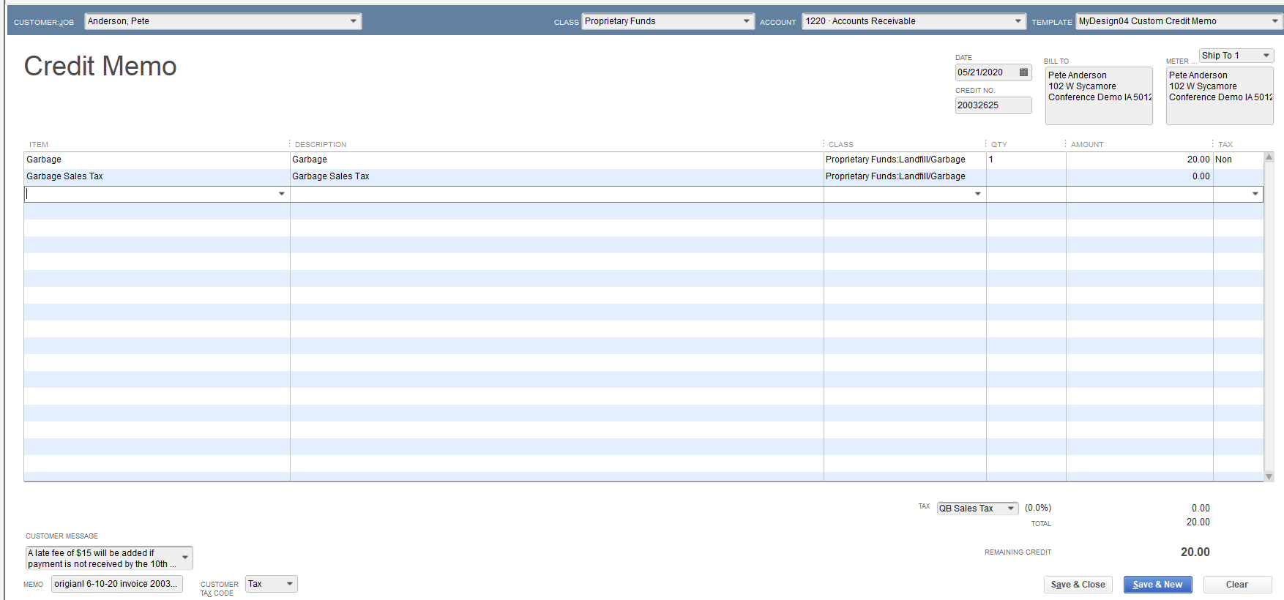
Write Offs
To decrease a utility bill
Open the original invoice and click the “Refund/Credit” button. Edit as necessary.
Add the original invoice number and original date to the credit memo in the memo field, as well as a note reminding you and the auditor why the utility bill is being decreased

Slide 14
Liens
To move a customer balance to a lien account:
(one-time only) Setup a new Item in the Item List called Lien Transfer. The item can point to a Charges for Services income account and should not be taxed.
(one-time only) Create a new customer account for the County Treasurer to hold all liens.
Create a sub customer (job) under the new County account with the original customer’s name (who you are submitting a lien for).
Create a credit memo for the original customer in the amount of the lien with the new Lien Transfer item. (This should be set up as a memorized transaction for you. Listed as Utility Bill Lien(1 of 2)).
Create an invoice for the new sub-customer (job) under County customer in the amount of the lien with the new Lien Transfer item. (This should be set up as a memorized transaction for you. Listed as Utility Bill Lien(2 of 2)).
© 2020 ClerkBooks, Inc

Slide 15
Liens
Step 4 & 5 from previous slide

Slide 16
Re-issuing Paychecks
To re-issue a lost paycheck:
Find the employee in the Employee Center.
Double click the paycheck that needs to be recreated.
Write down the check number and the check date.
Re-print this check as it is, simply change the check number to a new check number.
Create a “new” check (regular check, not a paycheck)
Use the old check’s number and date, write the check out to the employee, use Ask My Accountant for the account and leave the class blank.
Right click the check and mark it as Void.
© 2020 ClerkBooks, Inc

Slide 17
Re-issuing Paychecks
Steps 5-7 from previous slide

Slide 18
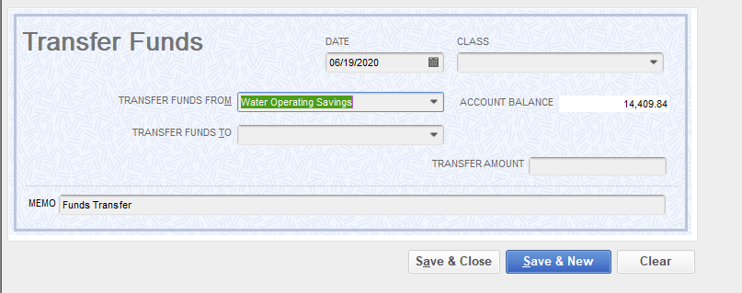
Transfers
There are 3 types of transfers that you could perform.
Two bank accounts & one fund
One bank account & two funds
Two bank accounts & two funds
Do NOT use the Transfer Funds option under Banking on the tool bar.
© 2020 ClerkBooks, Inc

Slide 19
Transfer - two bank accounts & one fund
Create a new “check”
The amount will be the amount you are transferring.
The transaction line will be the bank account the money is being transferred to.
The Fund will be the same as where the money was in the original bank account.

Slide 20
Transfer - one bank account & two funds
Create a new “check”
The check amount will be $0.00
The first line will be the transfer out & listed as a positive amount (expense or debit). It will be coded to the fund the money is coming from.
The second line will be the transfer in & listed as a negative amount (income or credit). It will be coded to the fund the money is going into.

Slide 21
Transfer - two bank accounts & two funds
Create a new “check”
The amount will be the amount you are transferring.
The first line will be to the bank account the money is being transferred to. The class will be the Fund it is going to.
The second line will be the transfer out & listed as a positive amount (expense or debit). It will be coded to the Fund the money is coming from.
The third line will be the transfer in & listed as a negative amount (income or credit). It will be coded to the Fund the money is going into.

